Slide 1

Business English for meetings
It’s a deal

Slide 2

Important is consensus in the meetings that you attend?

Slide 3
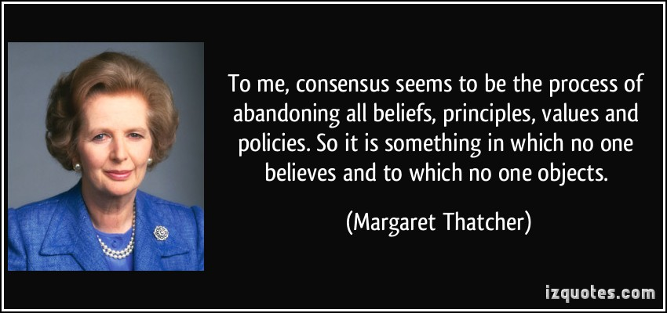

Slide 4
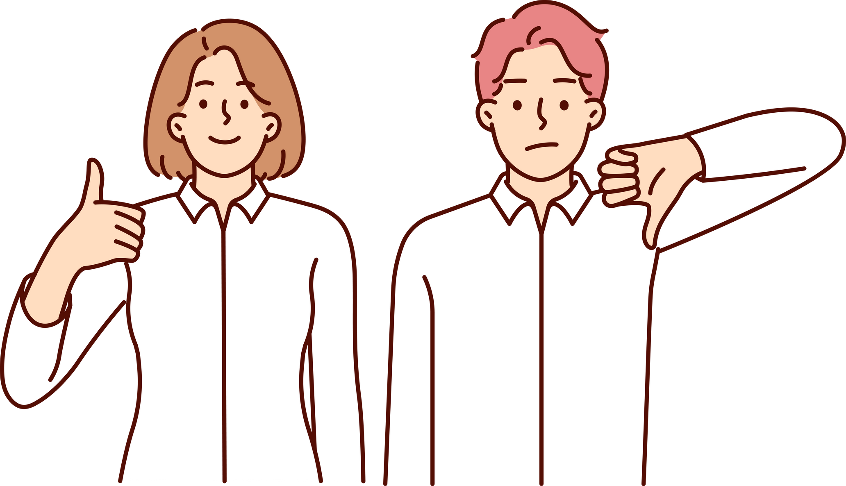
Do the meetings you attend usually end in agreement or disagreement?

Slide 5

  What sort of factors generally lead to disagreement?
  Is it normally possible to discuss the point causing disagreement until agreement is reached?

Slide 6

lets practice
match the phrases with the meaning

Slide 7
  I want to explore
  I’m sure that we can work
  If the price is right,
  Let’s leave the issue of price
  Once you’ve decided what you want,
  We’ll get back to you
  we’ll be able to buy more.
  until later.
  we’ll be able to get them out to you within a week.
  something out for you.
  as soon as we can on that.
  the possibility that you could help us with this.

Slide 8
Working together to reach an agreement
  It can be frustrating when some participants put off a decision and a meeting ends without agreement.
  In an international context, it’s important to understand the reasons for this.
for instance, in southeast Asian cultures it’s the group that’s important in decision making. An individual will seldom agree to something until a consensus has been reached among colleagues.

Slide 9

Talking about possibilities

Slide 10
Conditional 1 (to show that something is likely to happen)
    If the price is right, we’ll be able to buy more.
    If you prepare some different options for me, I’ll compare the prices and specifications.

Slide 11
Conditional 2 - to talk about things that are not certain)
(Could you deliver the system quickly if we gave you the order?
    We would be prepared to pay more if we received a good level of service back-up.

Slide 12
Useful phrases
  Rejecting an offer
    Sorry, but I’m not able to go along with that.
    Unfortunately, I won’t be able to take you up on that.
    I’m afraid I can’t agree to that.
    I don’t think that would be possible.

Slide 13
  Asking for time to consider
    I’d like a couple of days to think this over.
    Can I get back to you on that?
    I need some time to think it over.
  Accepting an offer
    I think we’ll go for that.
    That sounds good to me.
    That would be great

