Slide 1

Expressing opinion

Slide 2
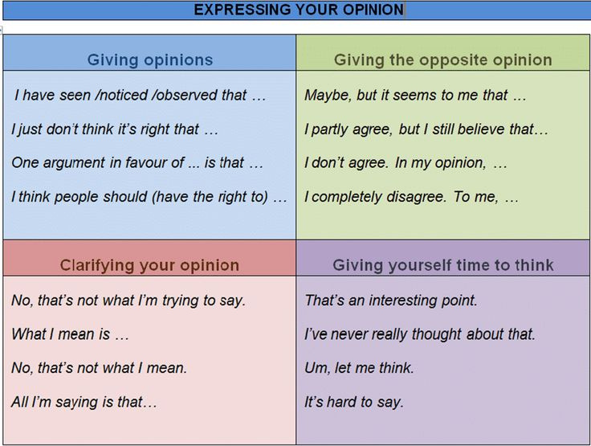

Slide 3


Slide 4





How convincing are you? Let's find out!
Petty Debate
1-on-1 Individual Edition

Slide 5



Welcome to the Petty Debate!
Are you ready to play?
This is a fast-paced debate game, where you can argue about the silliest things. No need to come up with incredibly serious points — make sure to defend your stance and have fun!

Slide 6



Your Game Masters
Team A
Team B

Slide 7
Rules of Petty Debate
Follow along and have fun!
1
You will battle each other individually. Your opponents will be assigned randomly.
5
They will have another 30 seconds each to respond and/or present new arguments.
2
The game master will choose a topic. A coin toss will decide which debater will defend what side.
6
Both debaters will be given 30 seconds each to make their final statements.
3
3 minutes is allotted for a single match-up.
Viewers will then be given 30 seconds to vote for the debater they strongly believe won that round.
7
4
Each debater will have 30 seconds to make their initial arguments.

Slide 8


Debate Topics
Chickens are the ultimate pets.
Lunch hour should be 2 hours.
Hotdogs are not sandwiches.
Books are better than movies.
Dogs have colored dreams.
(There are just some examples to get you started)

Slide 9


Are you ready?

Slide 10




Best Argument
Runner-Up
Player's Name

Slide 11




Thank you for joining!

