Slide 1

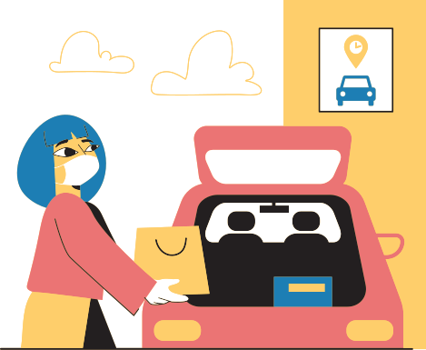
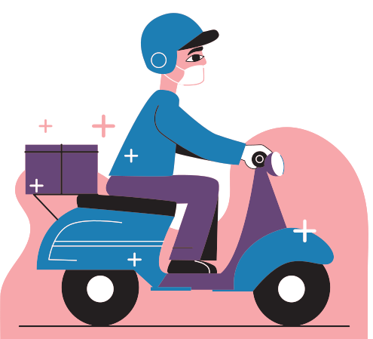
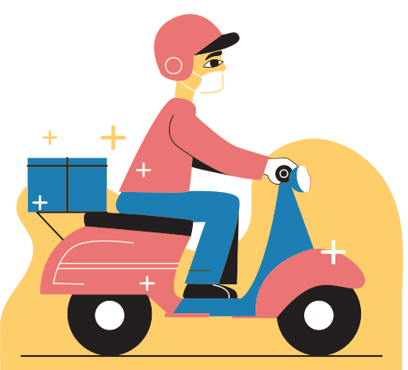
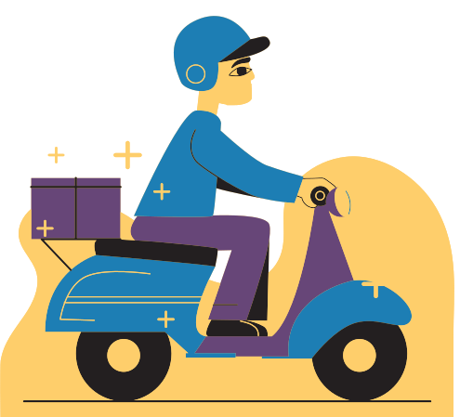
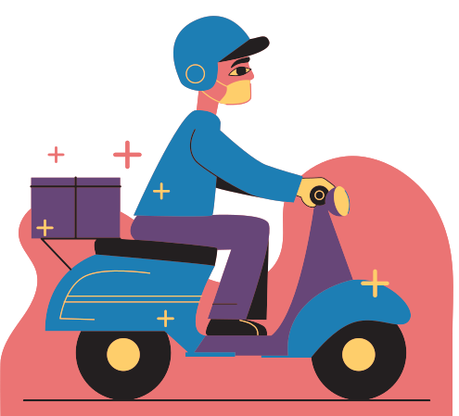
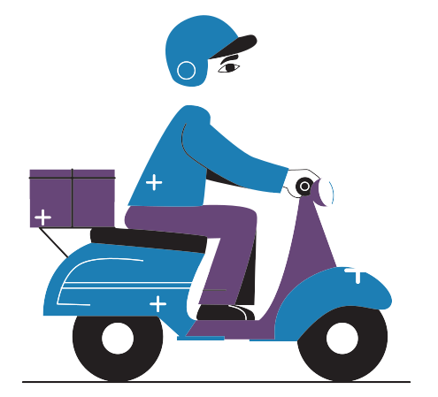
Shopping

Slide 2


Topic Outline
A
Introduction to New Normal Shopping
B
The Rise of Online Shopping
C
The Future of Shopping

Slide 3

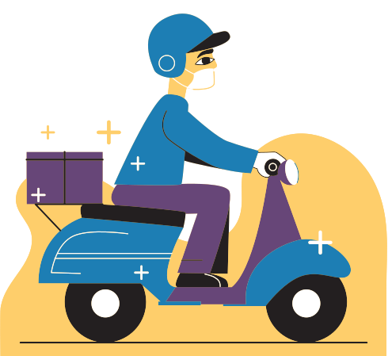
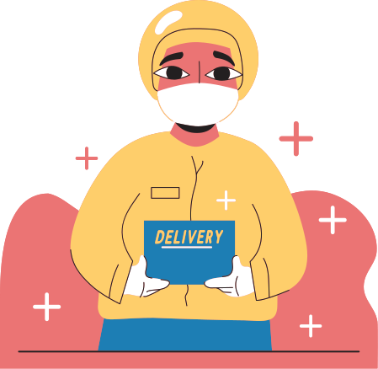
Introduction

Slide 4
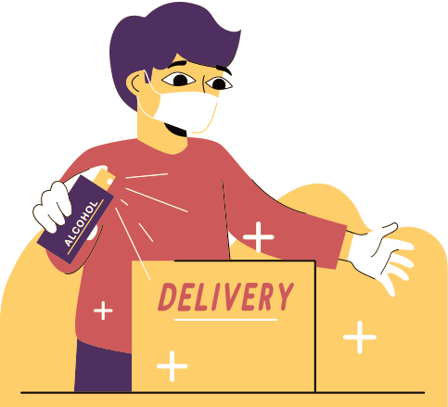
Introduction
What is the New Normal Shopping?
the new normal shopping are the habits that we adopted during the pandemic about shopping.
new people were introduced to online shopping as most cities all over the world went under a lockdown.

Slide 5

Physical vs. Online shopping

Slide 6
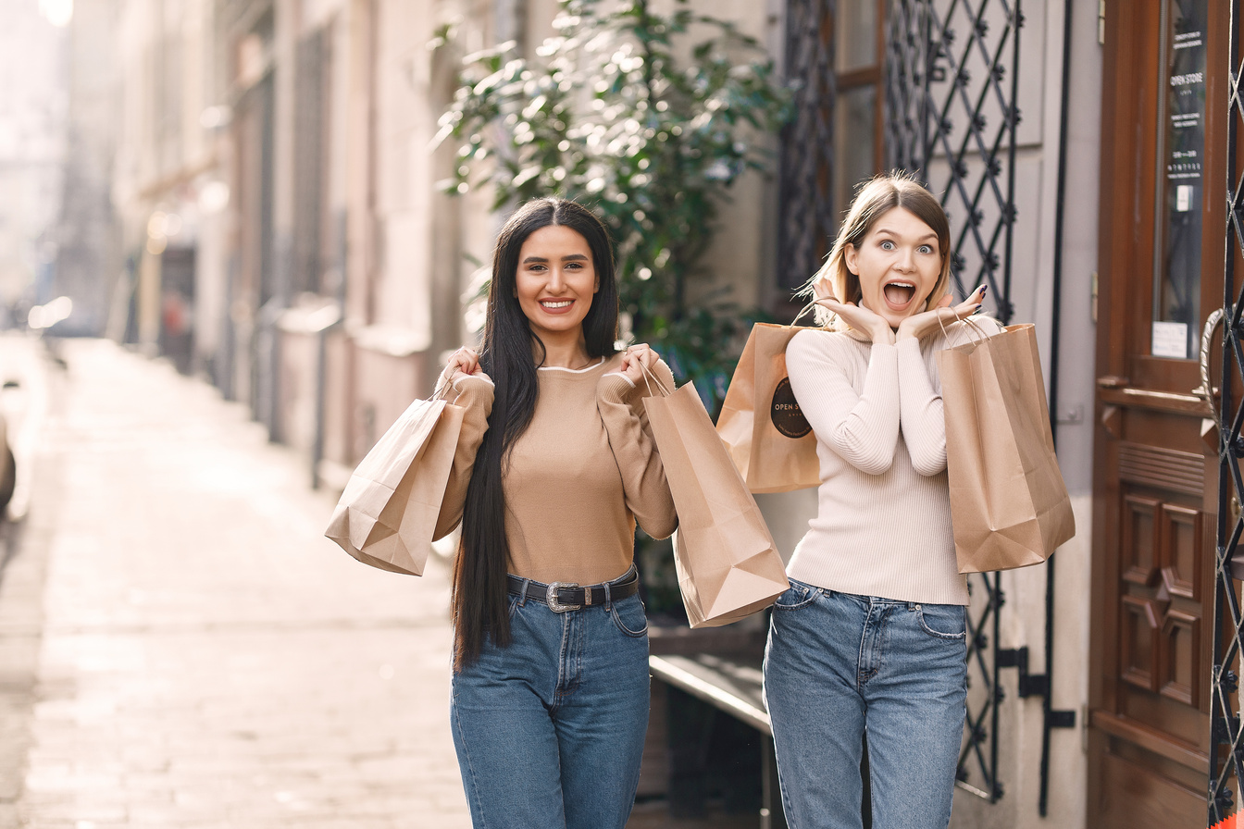
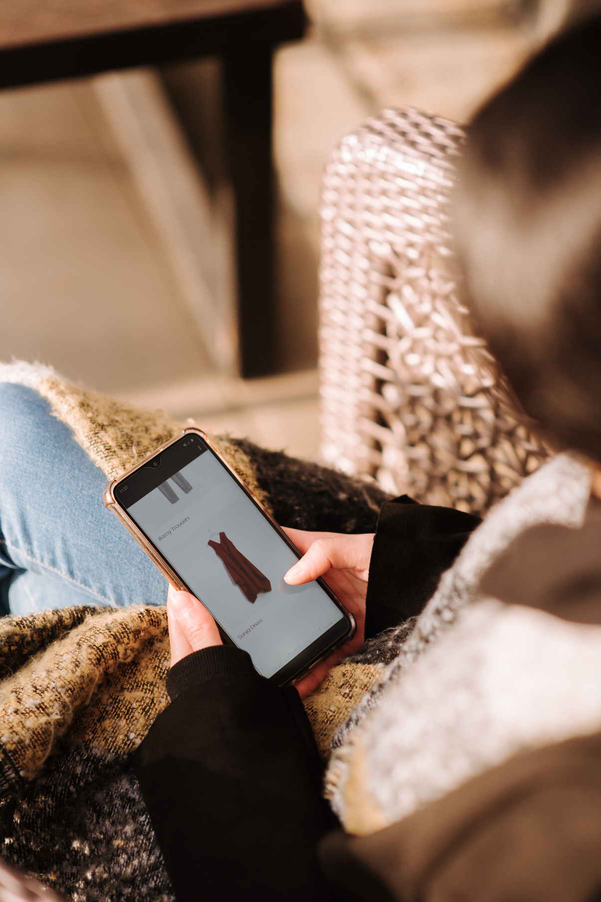
Physical
Online
  some goods can be bargained
  high start up cost
  reaches local area only
  response ony during business hours
  requires more employees
  fixed price unless during an offer
  low start up cost
  reaches worldwide cities
  response is flexible
  requires less employees

Slide 7
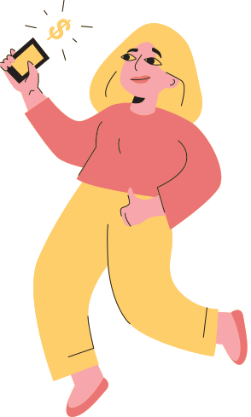
The Rise of Online Shopping

Slide 8
400
The Rise of Online Shoppers
300
Data from 2018-2022
200
100
0
2018
2019
2020
2021
2022

Slide 9
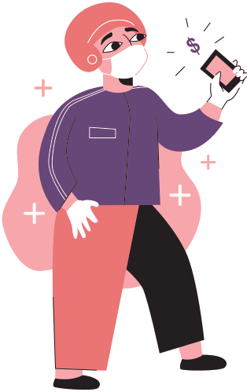
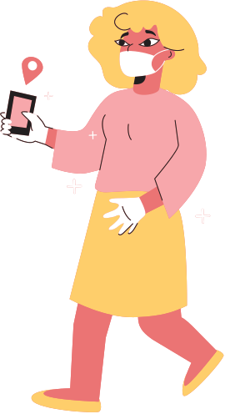
The Future of Shopping

Slide 10
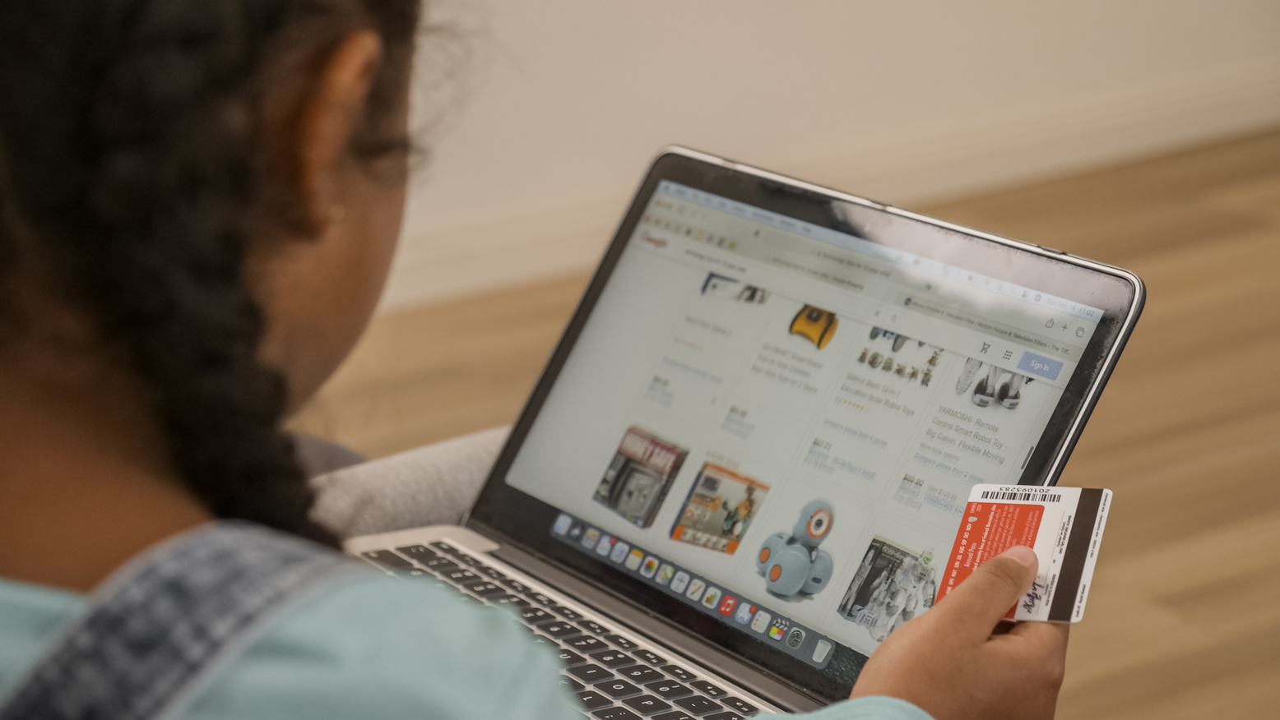

Cashless
Instant

Slide 11
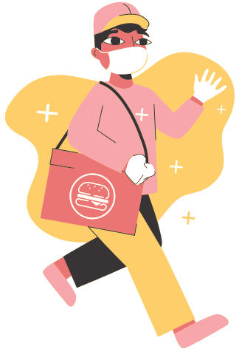
Thank you for reading!
Don't hesitate to ask any questions!

