Slide 1
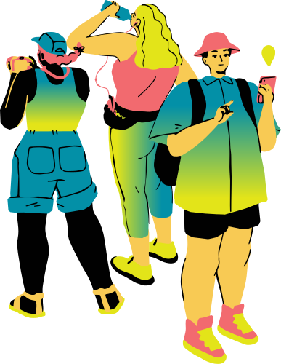


Travelling
making arrangemants

Slide 2
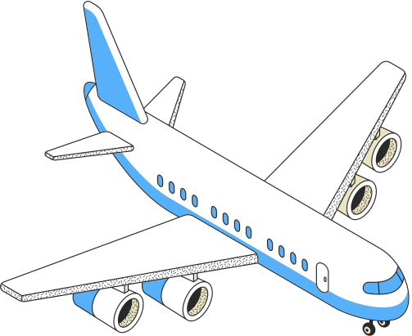

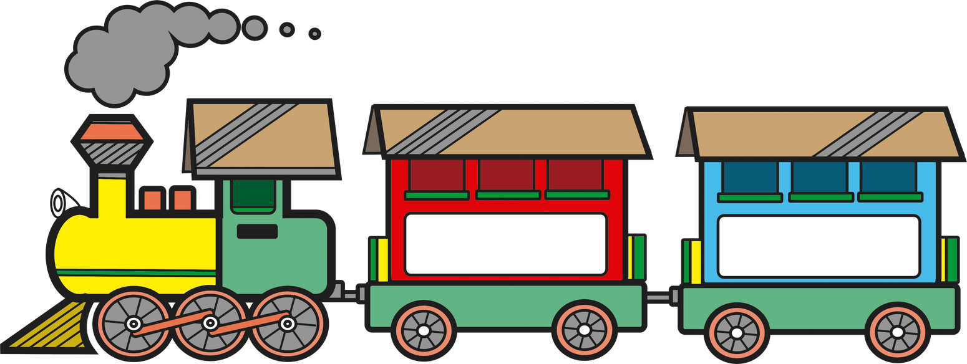
I would like to book a ticket
Where do you want to go?
Single or return?
First or standard class?
Is there a high-speed train?
How long does it take to get there?

Slide 3



Would you like to visit France?
No, I’m sorry but I can’t
Can you speak any French?

Slide 4
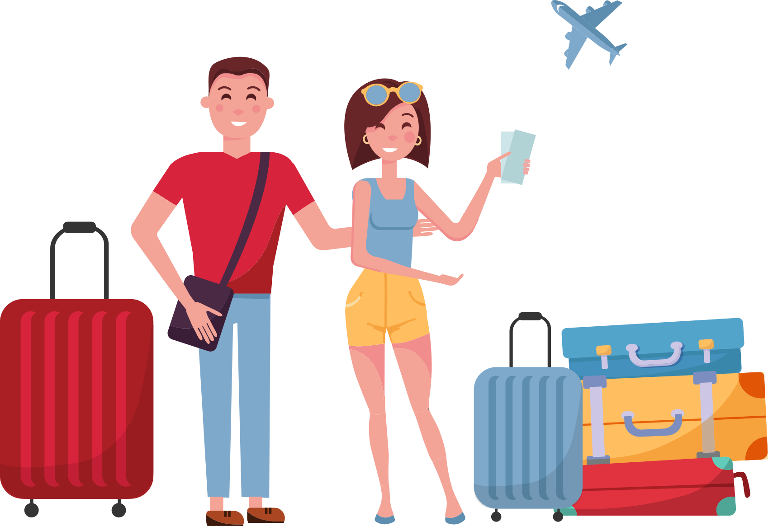
Porter, could you carry my luggage, please?

Slide 5
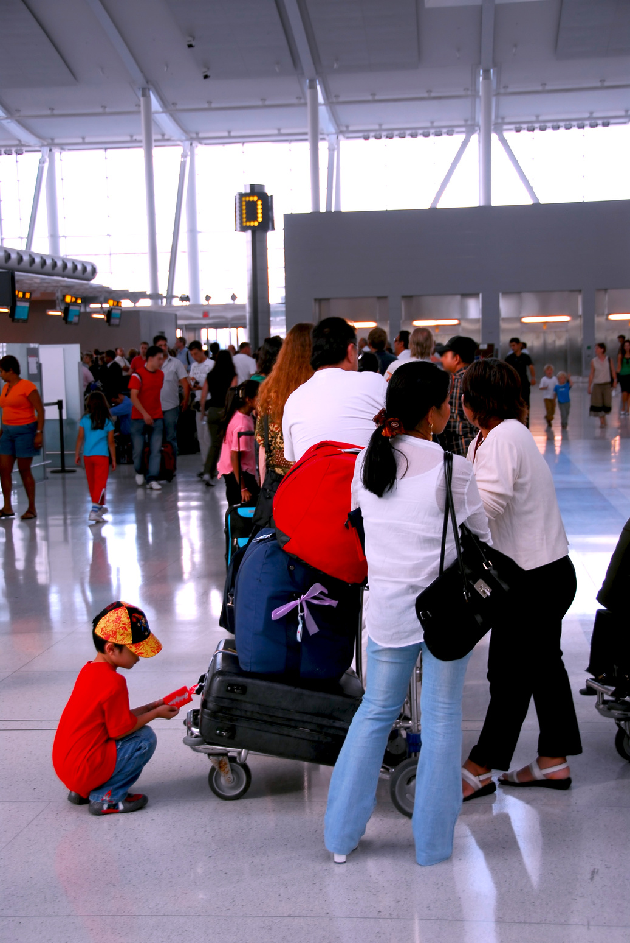
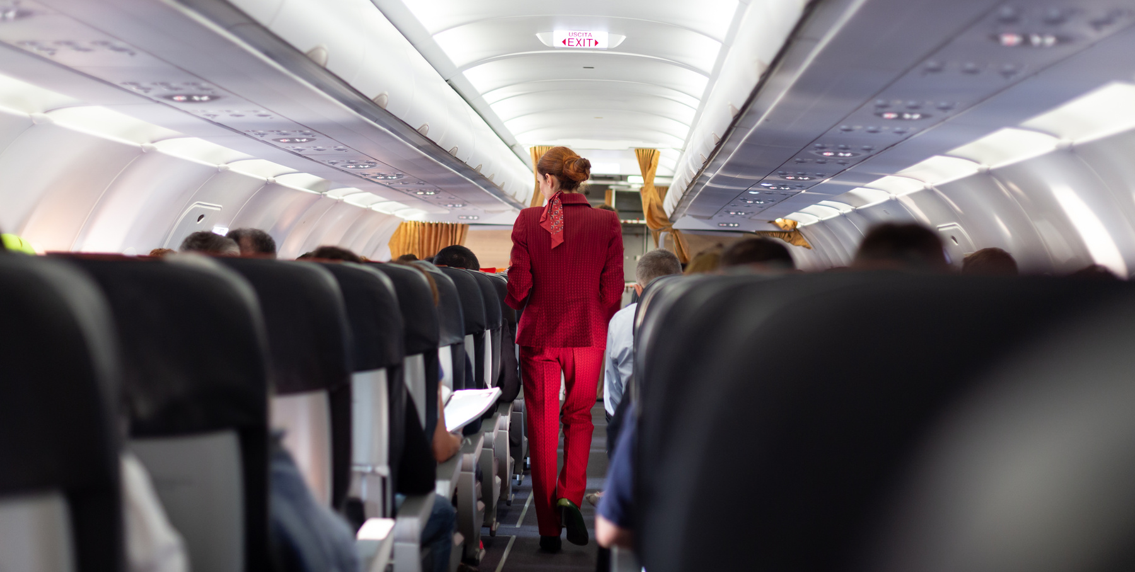
ENJOY YOUR TRIP!
HAVE A NICE TIME!
GOODBYE, FRIEND!
Don’t forget to send me a postcard!

Slide 6
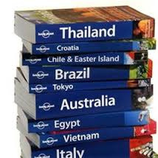
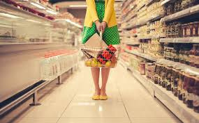
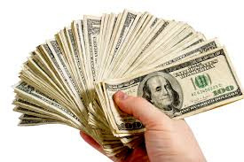

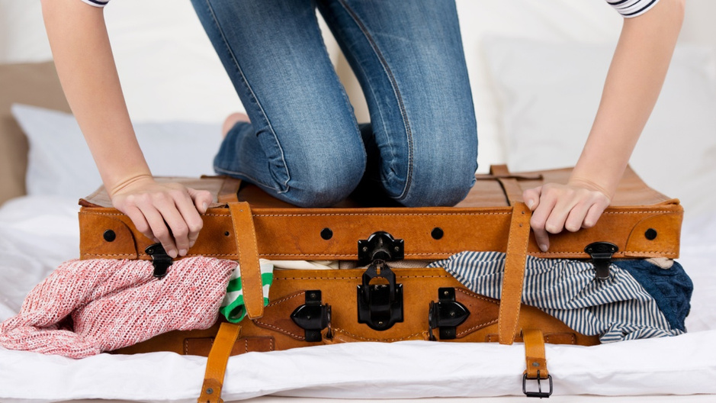
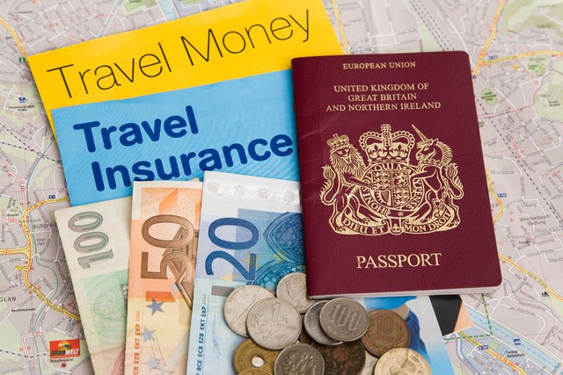
Holiday preparations

Slide 7
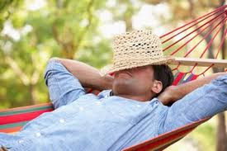

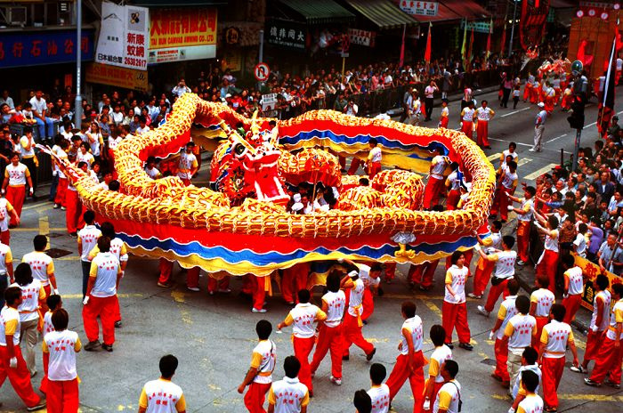
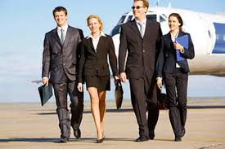
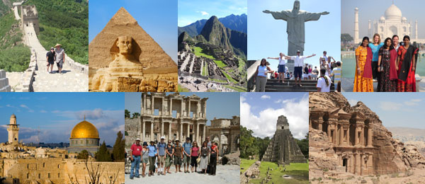
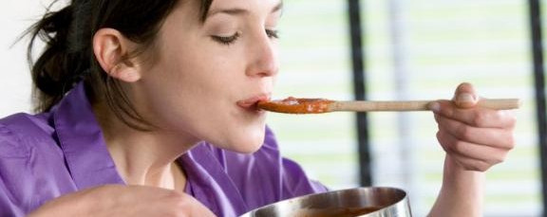
Why do people go on holidays?

Slide 8
Going on holiday…
Individual holidays
Package tours
Advantages
  Comfortable
  Flexible
  Disadvantages
  More expensive
  You have to organise everything→ tiring (book the accommodation, tickets, driving, etc.)
Advantages
  Organised programmes
  Tourist guide (information)
  Lower travelling costs
  Disadvantages
  You have to be adoptable
  Crowded vehicle (too many people)

Slide 9
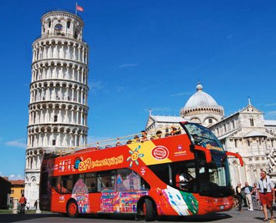
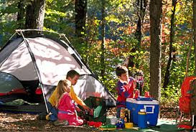
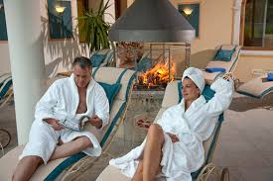
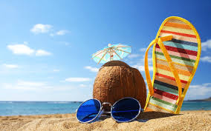
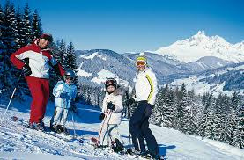
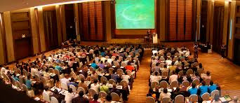
Holidays

Slide 10
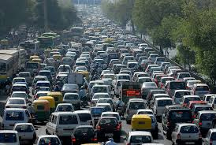
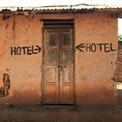
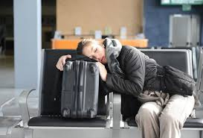
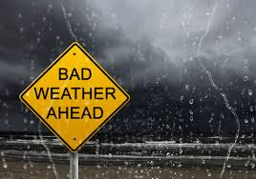

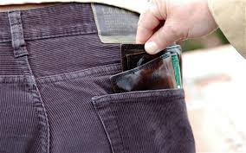

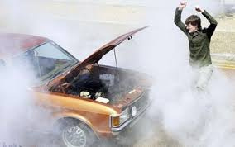
Holiday nightmares

Slide 11

Thank you for your participation! ☺

