Slide 1


Discover Your Wellness
Improve your wellness by knowing the basic of wellness.
Let's start our journey on the next page
Next

Slide 2

Definition of Wellness
Wellness is a condition where one should do activities in order to improve your physical and mental health and ensure that you are thriving rather than merely getting by, wellness is the daily practice of healthy practices.
Continue to the next page
Next

Slide 3

Table of Contents
01
02
03
04
05
Cover
Definition
Table of Contents
Self-Care Routine
Meditation
09
12
13
14
15
Dimensions of Wellness
Positive Affirmations
Stress Management
Mindfulness Skills
Thank You
Continue to the next page
Next

Slide 4

Self-Care Routine
Know what self-care routine is and what can you do
Next

Slide 5

Meditation
A set of methods used to promote increased awareness and concentrated attention might be referred to as meditation. Another method of altering consciousness that has been demonstrated to have numerous advantages for psychological health is meditation.
Continue to the next page
Next

Slide 6
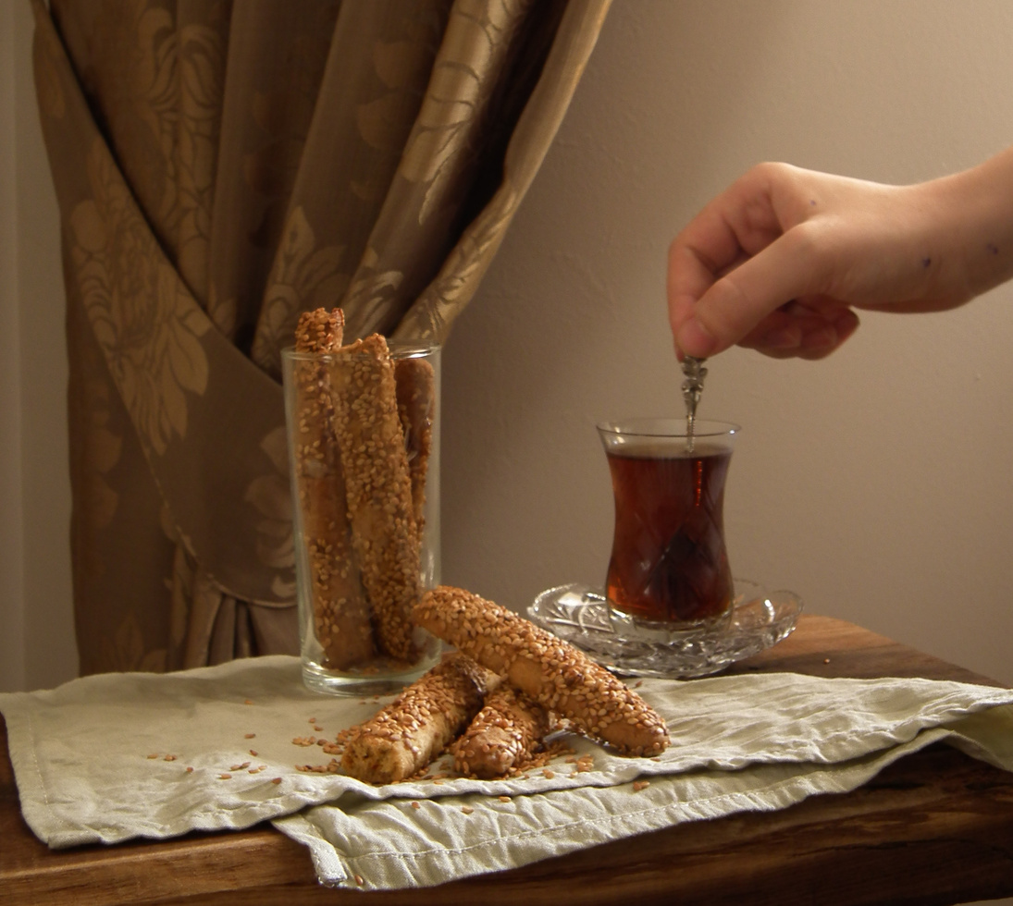
Healthy Food
Healthy food fewer than ten ingredients and no unpronounceable ingredients are what this term refers to. It entails having a relationship with the people who grow your food, having access to nourishing, culturally relevant foods, and having a secure environment in which to share them with your loved ones.
Continue to the next page
Next

Slide 7


Exercise
Exercise is a physical activity that maintains or improves physical fitness as well as general health and wellness. By doing exercise in your life you will get many benefits from it.
Continue to the next page
Next

Slide 8


Mindfulness
By maintaining a kind, caring perspective on our thoughts, feelings, bodily sensations, and the environment around us, we can practice mindfulness.
Judgement
Judgement is where one have the capacity to decide carefully or reach logical conclusions. With the well made judgement, we can earn wellness and peace.
Continue to the next page
Next

Slide 9

Dimensions of wellness
What kind of different side of wellness are there?
Next

Slide 10
Physical
Emotional
Physical wellness includes all facets of health that have to do with the body's physical components, such as diet, exercise, weight management, and more. The opportunities to improve your physical wellness status offered by the resources listed in this section can have a positive effect on your general health and wellness.
One of the eight dimensions that affect overall health and wellness is emotional wellness. The capacity to recognize and manage one's own emotions. Emotional wellness is defined as the capacity to successfully manage life's stresses and adapt to change and difficult circumstances.
Continue to the next page
Next

Slide 11
Social
Spiritual
Social wellness encompasses all aspects of wellbeing pertaining to social connections, relationships, and personal expression. The resources listed in this section are opportunities designed to optimize your social wellness status, which can positively impact your overall health and wellness.
Spiritual wellness can include having faith in a higher power, but it is not necessary for it to be connected to a particular religion. The opportunities to improve your spiritual wellness are provided in this section and can have a positive effect on your general health and wellbeing.
Continue to the next page
Next

Slide 12

Positive
Affirmations
Positive phrases or statements that we repeat to ourselves are known as positive affirmations. They are typically used to bring about the desires we have for experiences, dreams, or goals.
Continue to the next page
Next

Slide 13
Stress Management
Make Self-Care Priority
Make a priority list and start from the one that you need to do first for your self-care routine
Manage Your Time
Learn How to Relax
You can manage stress by efficiently managing your time
We have less time to relax when we're busy, but try to have a small break here and there
Continue to the next page
Next

Slide 14
Mindfulness Skills
Having strong mindfulness skills helps us to have growing healthy wellness for our wellbeing. This also could help us achieve peace for a long period of time.
Strong
Having poor mindfulness skills would be a disadvantage for a long-term goal where we would want to achieve wellness and peace
Poor
Continue to the next page
Next

Slide 15
Thank You
May your journey ends with blessed improvements!

