Slide 1






Complex sentences

Slide 2

Overview
  Introduction
  Sentence Structure Review
  Dependent Clauses
  Subordinating Conjunctions

Slide 3

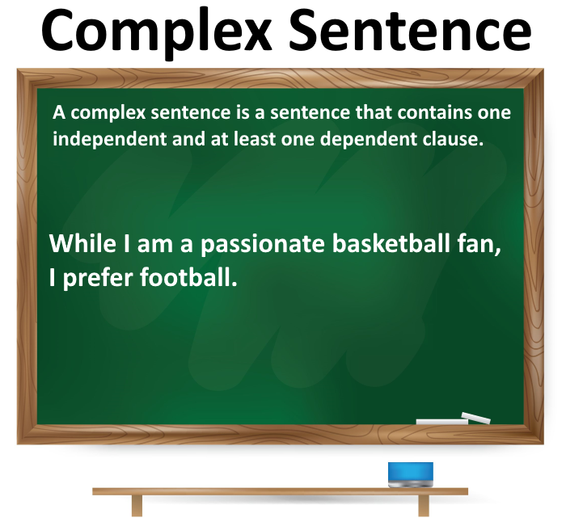


Introduction

Slide 4

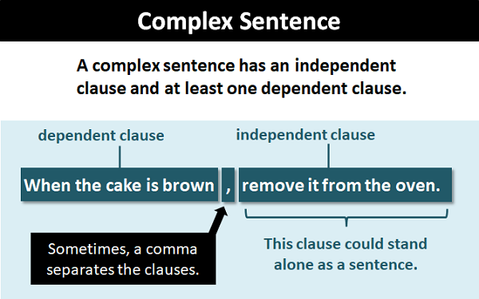
parts of a complex sentence

Slide 5

IMPORTANCE OF USING COMPLEX SENTENCES IN COMMUNICATION
1. Conveying Nuance and Depth: Complex sentences allow you to express intricate relationships, connections, and nuances between ideas. They enable you to delve deeper into your subject matter and provide a more comprehensive understanding for your audience.
Example: While technology has revolutionized the way we work and communicate, it has also raised ethical concerns about privacy and data security.
2. Expressing Cause and Effect: Complex sentences enable you to clearly indicate cause-and-effect relationships between different aspects of a topic, helping your audience understand the reasons behind certain phenomena or outcomes.
Example: The increase in greenhouse gas emissions has led to a rise in global temperatures, resulting in more frequent and severe weather events.

Slide 6
3. Enhancing Formal Writing: In academic, professional, or formal writing, the use of complex sentences demonstrates a higher level of language proficiency and sophistication. It adds a sense of professionalism and authority to your work.
Example: The proposed economic policy, while ambitious in its scope, has garnered support from prominent economists due to its potential to stimulate sustainable growth.
4. Captivating and Engaging the Audience: Complex sentences, when used effectively, can captivate your audience's attention and engage them in your message. Well-constructed complex sentences can contribute to a more dynamic and interesting communication style.
Example: As we navigate the uncharted waters of the digital age, it is imperative that we adapt our educational strategies to equip the next generation with the critical thinking skills necessary to thrive in an ever-evolving landscape.

Slide 7



Types of dependent clauses
There are 3 types of dependent clauses:
noun, adjective, adverb

Slide 8

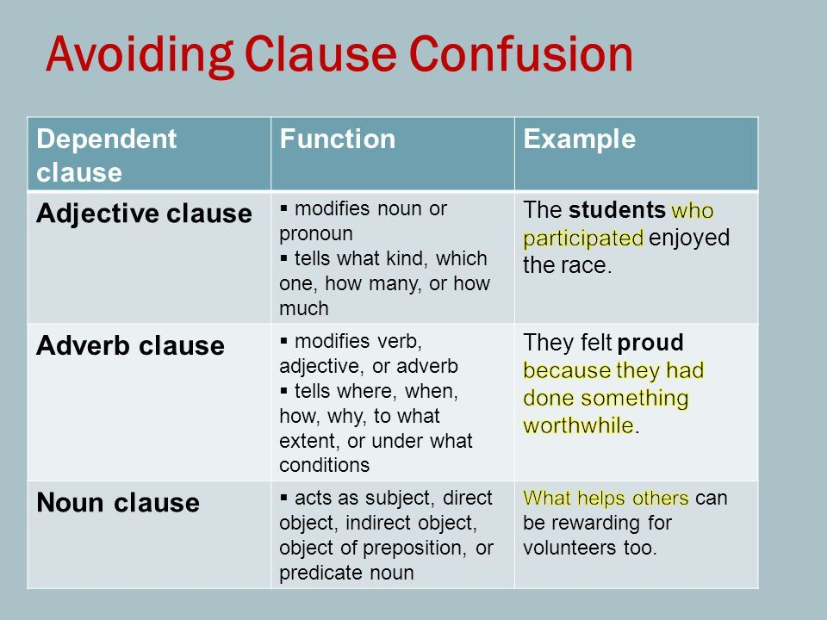


Slide 9

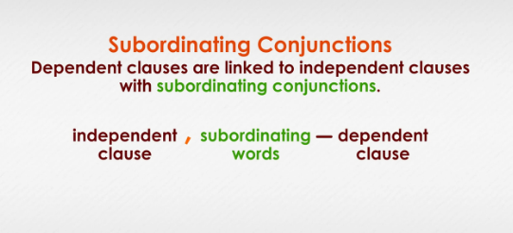

Slide 10
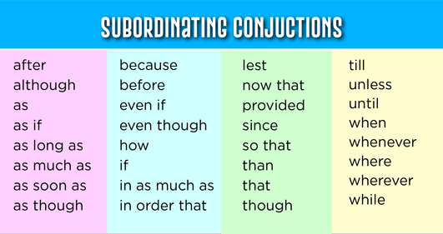

Slide 11
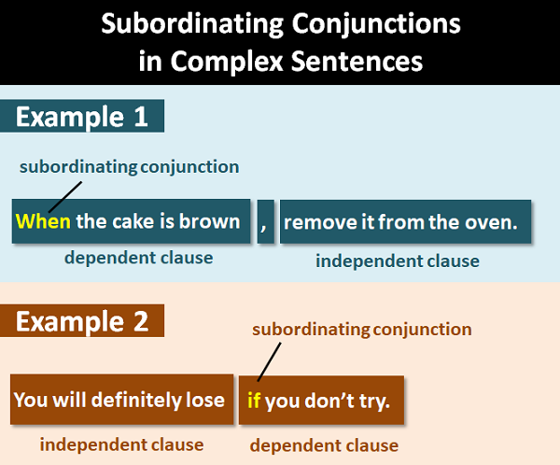


Slide 12


Thanks

