Slide 1






Passive voice

Slide 2

Overview
  Introduction
  Sentence Structure Review
  Dependent Clauses
  Subordinating Conjunctions

Slide 3



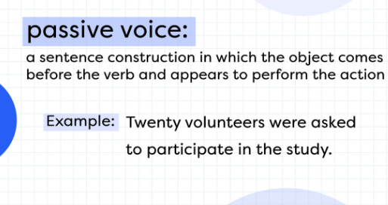
Introduction

Slide 4

PURPOSE:
Emphasizing the action or result, focusing on the object, or making the sentence more formal.

Slide 5
STRUCTURE OF PASSIVE VOICE
  Subject + Form of "to be" (is, am, are, was, were, has been, have been, had been, will be, etc.) + Past Participle of Main Verb
  Example: Active - "She bakes the cake." Passive - "The cake is baked by her."

Slide 6

WHEN TO USE PASSIVE VOICE
  Unknown or Unimportant Doer
  Focus on Action or Result
  Obvious Doer from Context
  Formal or Objective Tone

Slide 7


Active vs. Passive Voice
  Active Voice: Subject performs the action.
  Passive Voice: Subject receives the action.
  Example
Active - "The teacher explains the lesson."
Passive - "The lesson is explained by the teacher."

Slide 8

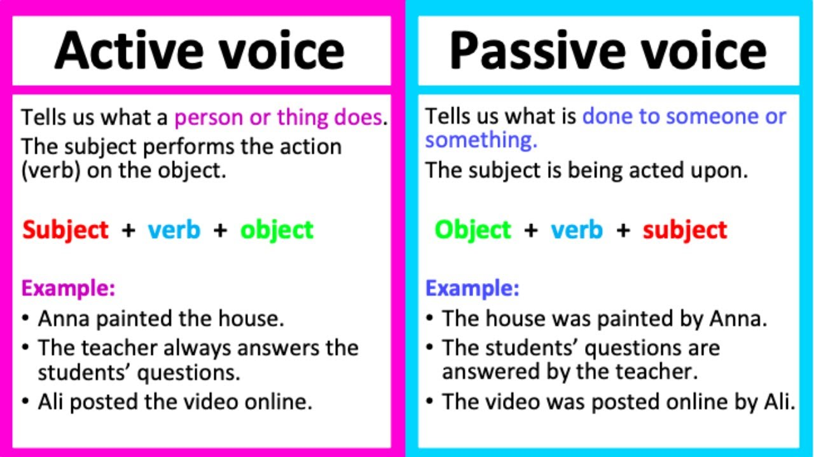

Slide 9
Common Passive Voice Tenses
  Present Simple: "The report is written weekly."
  Past Simple: "The letter was sent yesterday."
  Present Perfect: "The project has been completed."
  Past Perfect: "The work had been finished before the deadline."

Slide 10

Passive Voice with Modals
  Modal Verbs (can, could, should, must, etc.) in Passive Voice
  Indicating Possibility, Necessity, or Obligation
  Example: "The contract should be signed by Friday."

Slide 11

Passive Voice and Object Focus
  Emphasizing the Object of an Action
  Example:
Active - "She painted the mural."
Passive - "The mural was painted by her."

Slide 12


Thanks

